Slide 1


Slide 2

Company history
Temasek Therapeutics was founded in 2015 by 5 co-founders from A*STAR (Agency for Science, Technology and Research), NUS (National University of Singapore) and NTU (Nanyang Technological University).
Received seed stage funding of SG$921,888 in January 2015 under A*STAR, JCO (Joint council projects grants)

Slide 3

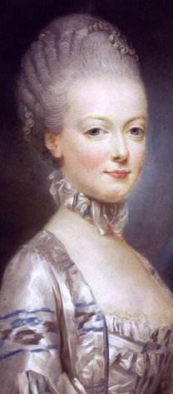
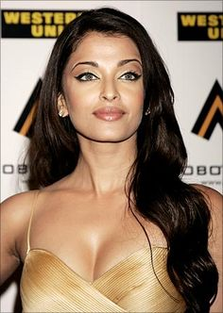
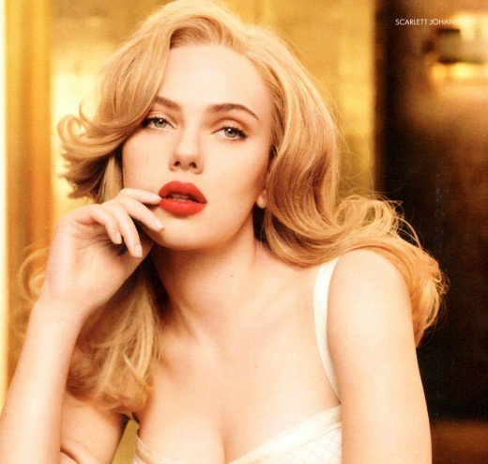
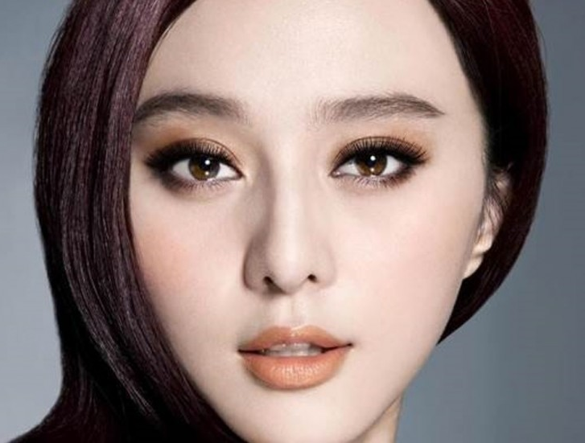
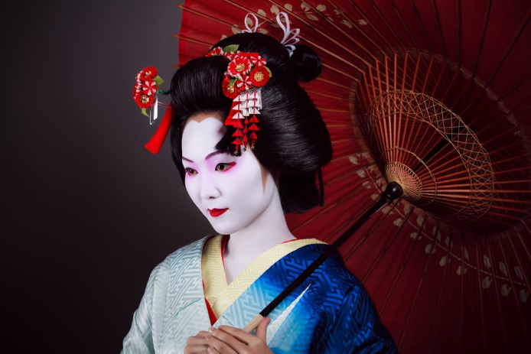

A desire for fair skin throughout the ages..

Slide 4
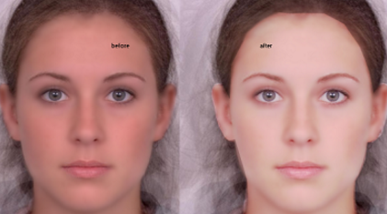
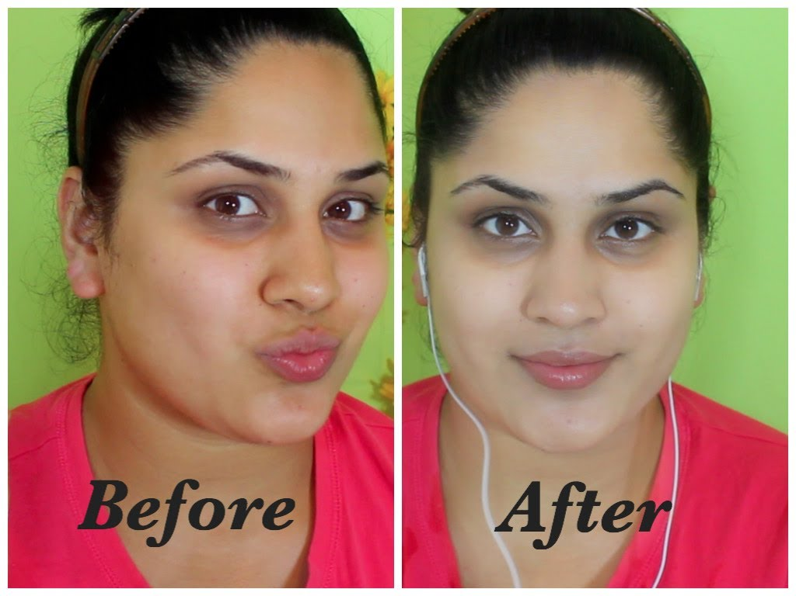
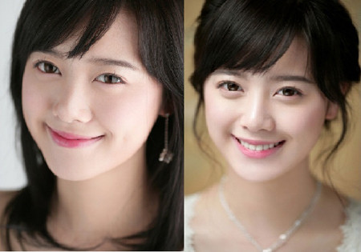
Before and After

Slide 5
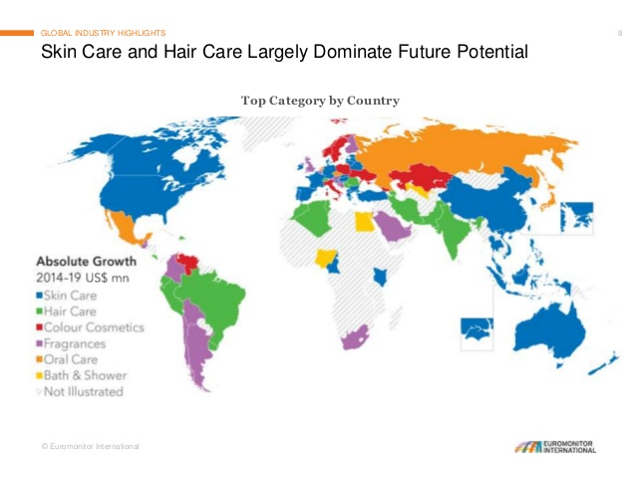
Market size
Global skin lightening market ~$23B
57% in Asia Pacific
$3.9B market in China

Slide 6
Solution
Customised dose of siRNA adjusted to individual skin conditions
siRNA hydrogel in a pen applicator
Lum|na™
露美™
露出真美

Slide 7
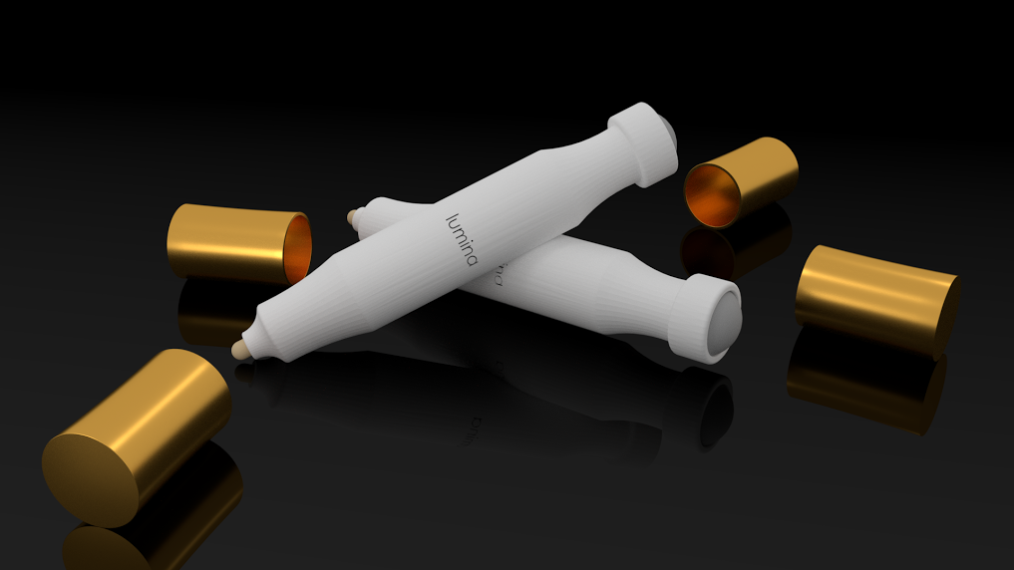
Lum|na™
露出真美

Slide 8
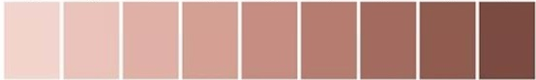

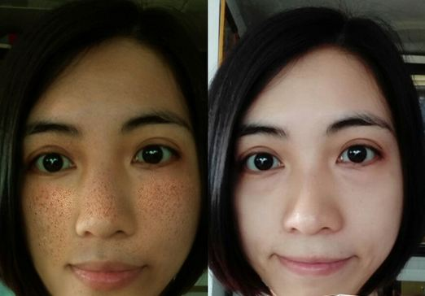


Product
Choose your desired tone
Snap a selfie on our app
Let us analyze the best solution for you
Doorstep delivery

Slide 9
Product
Before
After 2 Weeks

Slide 10
IP status
Proprietary server-side algorithms
  Machine learning performed using private dataset of 15000 women
  100% secure
Inventions assigned to NUS
  2 U.S. patents granted
  2 PCT (Int’l) application
    Aug 2016 approved as functional cosmetic by SFDA
Notes:
Patents granted:
siRNA in decreasing melanin production
Hydrogel encapsulation of siRNA for release
Patent pending:
Use patent of hydrogel in combination with siRNA for synergistic effect
Process patent of using selfie to lead to formulation of siRNA

Slide 11





Business Model
Subscription model
  Free skin analysis
  $88 per formulation
Sales channels
  Direct sales through own app/website
Uploading of photograph
Customization of formulation
Application
Analysis
Delivery

Slide 12



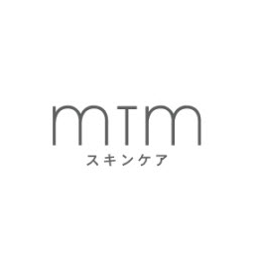








Competitors
Pricing
$
$$
$
$$$
$$
Customizability
✗
✗
✓
✓
✓
Analysis
✗
Active Ingredient
Application

Slide 13





Marketing Plan
Social influencers
Mobile advertisements
Creating a community
Story telling
Trials
Notes:
A recent consumer behaviour report on women in China shows increasing acceptance rates towards technology. People are more trusting of online sources and prefer to purchase and socialize on the Internet. Hence our marketing strategy focuses strongly on Internet usage.
Use report from Mintel (Consumer behavior of women in China)
Channels
Videos
Tie-ins with online celebrities
Interactive apps
Tracking progress
Crating an online community
Social media advertising (also for women-only services)
Monthly boxes (vouchers)

Slide 14
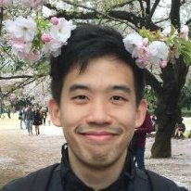
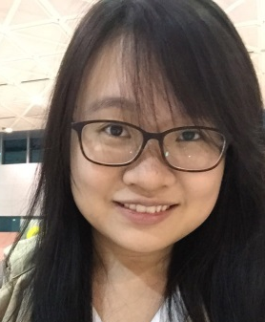
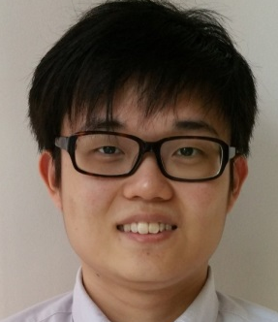
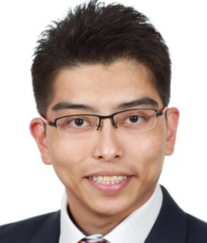
Executive Team
CEO
CTO
CMO
CSO
CFO
Mr Larry Loo
Mr Jackie Tan
Ms Cally Owh
Mr Kenny Low
Dr Delon Toh
A*STAR IMCB Scholar
Singapore-Stanford Biodesign 2015 Alumni
NTU President Scholar
Serial Entrepreneur
A*STAR IMRE Scholar
Inventor of patented hydrogel technology
A*STAR IMRE Scholar
Inventor of patented hydrogel technology
NGS Scholar
Inventor of patented siRNA technology

Slide 15
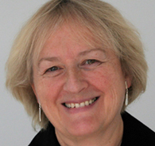
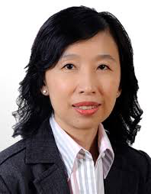
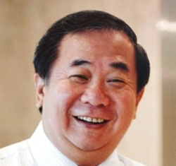
Advisory board members
Professor
Birgit Lane
Honorary Consultant of National Skin Centre
Professor
Tan Suat Hoon
Senior consultant Dermatologist
Director of National Skin Centre
Professor
Freddy Boey
Deputy President & Provost of NTU
President's Science and Technology Medal

Slide 16


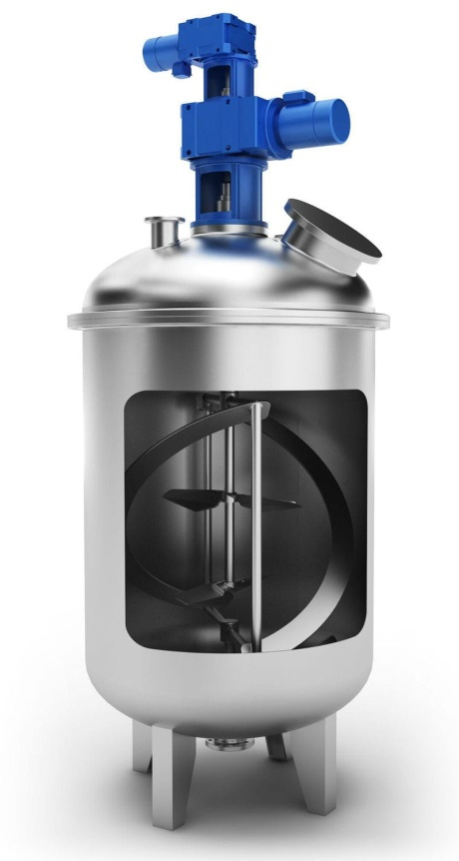

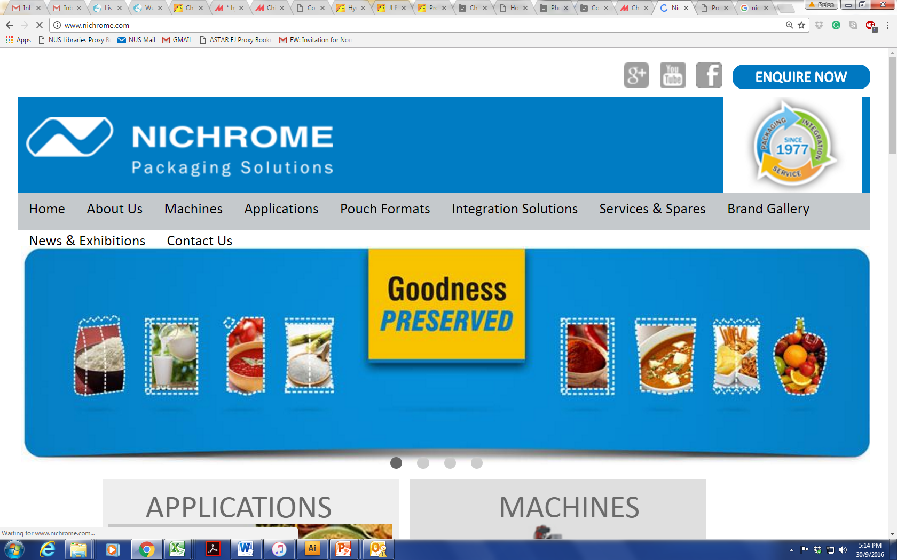
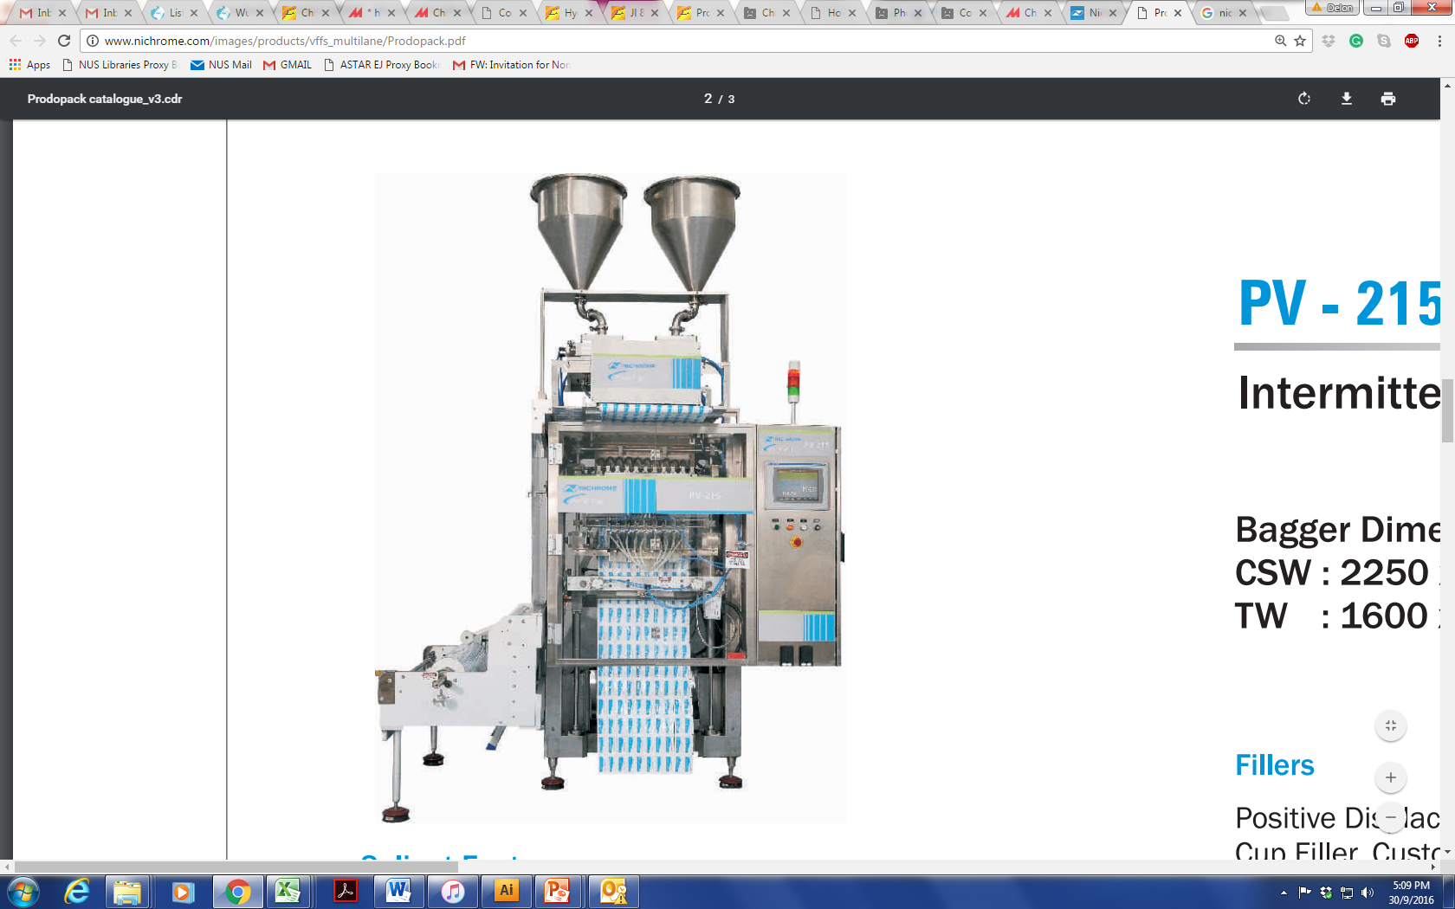



Financial
Raw Materials
Mixing
Packaging
siRNA
1.02 USD/unit
1.12 USD/unit
PV-215
Hydrogel Suppliers
5.86 USD/unit
6.21 USD/unit
Applicator
0.4USD/unit
Sk700 Coaxil Mixer
30,000 USD
0.45USD/unit
65,000 USD
Notes:
Arshine Pharmaceutical Co., Limited
ChemFine International Co., Ltd.

Slide 17
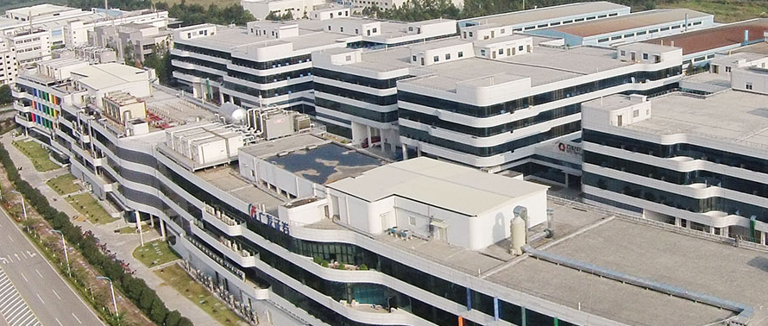

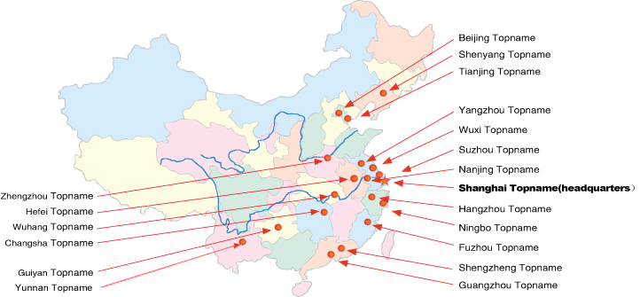


Financial
Pearl River Industrial Park
App Development/Cloud
20,000 USD/year
30,000 USD/year
1400 sqm
Manpower
B2C
200,000 to 800,000 USD/year
4 (FY2) to 16 (FY5) manufacturing staff
3 USD/unit

Slide 18
Financial
 | FY 1 | FY2 | FY3 | FY4 | FY5
Units produced | 0 | 40000 | 120000 | 240000 | 360000
Revenue | 0 | 3520000 | 10560000 | 21120000 | 31680000
COGS | 0.00 | 415,200.00 | 1,245,600.00 | 2,491,200.00 | 3,736,800.00
Logistics | 0.00 | 10,000.00 | 30,000.00 | 60,000.00 | 90,000.00
Direct Expenses | 0.00 | 425,200.00 | 1,275,600.00 | 2,551,200.00 | 3,826,800.00
Product | 125,000.00 | 107,800.00 | 215,900.00 | 381,800.00 | 547,700.00
Manufacturing | 343,000.00 | 486,050.00 | 779,350.00 | 912,650.00 | 1,051,950.00
Marketing & Sales | 356,500.00 | 1,134,500.00 | 2,376,000.00 | 5,384,550.00 | 12,090,082.50
Indirect Expenses | 824,500.00 | 1,728,350.00 | 3,371,250.00 | 6,679,000.00 | 13,689,732.50
 |  |  |  |  |  | Total
NPBT | -824,500.00 | 1,366,450.00 | 5,913,150.00 | 11,889,800.00 | 14,163,467.50 | 32,508,367.50
NPAT (25%) |  | 748,075.00 | 4,434,862.50 | 8,917,350.00 | 10,622,600.63 | 24,722,888.13

Slide 19
Investment
USD 1,000,000 for 35% equity
USD 9,800,000 in 5 years
 | FY1 | FY2 | FY3 | FY4 | FY5
NPBT | -824,500.00 | 1,366,450.00 | 5,913,150.00 | 11,889,800.00 | 14,163,467.50
NPAT (25%) |  | 748,075.00 | 4,434,862.50 | 8,917,350.00 | 10,622,600.63
Risk Group | Early Startup | First Stage | Second Stage | Second Stage | Late Startup
Risk Rate | 50-70% | 40-60% | 30-50% | 30-50% | 10-35%
Discount Rate | 65% | 60% | 50% | 45% | 35%
Discount Factor | 0.61 | 0.55 | 0.46 | 0.41 | 0.3
Current Value | -502,945.00 | 411,441.25 | 2,040,036.75 | 3,656,113.50 | 3,186,780.19
Perpetuity growth model | 6%
Discounted continuing value | 19,419,276.84
Equity Value | 28,210,703.53
35% Equity | 9,873,746.23
ROI | 8.87

Slide 20







Thank you
Q&A

Slide 21
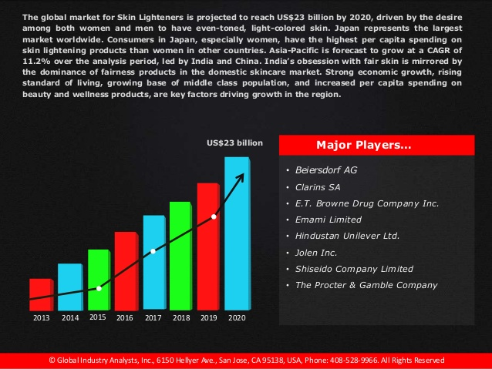
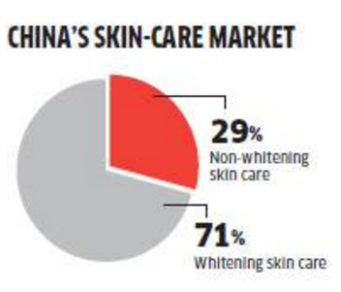
Appendix – Market size
Bottom up approach
Total china population 1.3 billion
% Demographics of women (25-54 years old) (313Million)
% use them(30%)
% middle class women who can afford these (20%)
How much they spend annually on skin lighteners ~$200USD
Total skin light market $3.79B
Top down approach
How much skin lighteners global market size
China skin lighteners market size
$23B * 57% (Asia Pacific)
$5.61B * 70% = $3.9B

Slide 22
Appendix - Marketing
Mintel China Consumer Trends 2016 Report
Increasing mobile penetration, customers are
  Spending more time online
  Paying for more web-based services
“74% of Chinese
consumers find interactive activities held by brands encourage them to purchase.”
“60% of Chinese consumers have made a purchase by clicking on an ad on social and media networks”

Slide 23
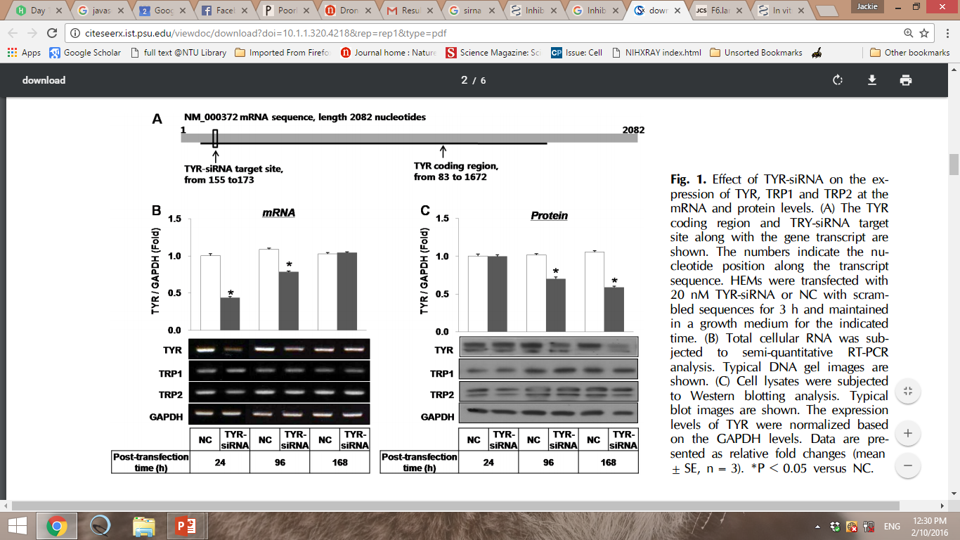
Appendix – Pre-clinical trial data
MITF
MITF

Slide 24
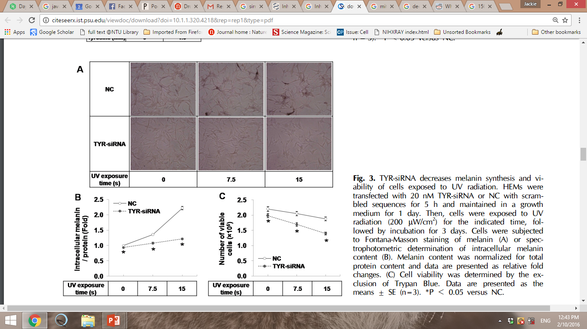
Appendix – Pre-clinical trial data
MITF-siRNA

Slide 25
Appendix – App machine learning
  Current problem: It is hard for machine vision to differentiate between moles, freckles, and blemishes.
  Solution: Perform deep neural network machine learning (same as AlphaGo) to be able to segment the areas of a face
  Dataset used: 15042 women from different Beijing and Shanghai
    13838 faces collected privately (training set)
    1204 faces provided by Meitu Xiuxiu (validation set)
  Results:
    98% accuracy in segmenting the face according to freckles and skin tone
    95% accuracy in providing optimal regiment for face based on segmentation and tone request

Slide 26
Appendix – Clinical trial data
Collaborated with Dr Tan Suat Hoon to test the effects of Lumina
150 women were recommended the regiment based on the app, and were followed for one month
  Age range: 25-50
  Healthy
  Pre-screened for melanoma incidences
  78 women had freckles covering >15% of face
  30 women had age blotches
Desired skin tone achieved in 96.66% of the women after treatment
siRNA level required in cell study correlated well with amount used for humans
Superb recommendation by app
3.33% required one more month and dosage adjustment for freckles to completely disappear

Slide 27
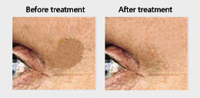
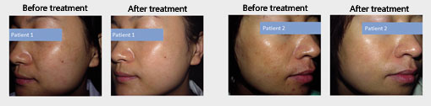
Appendix – Clinical trial data

Slide 28
Appendix – Finance
 | Marketing & Sales
 | FY 1 | FY2 | FY3 | FY4 | FY5
Website | 500 | 500 | 500 | 500 | 500
Bloggers | 20,000 | 25,000 | 30,000 | 35,000 | 40,000
Regulatory Red-tapes | 20,000 | 25,000 | 30,000 | 35,000 | 40,000
Wechat | 2,000 | 3,000 | 4,500 | 6,750 | 7,088
Taobao | 2,000 | 3,000 | 4,500 | 6,750 | 7,088
Alibaba | 2,000 | 3,000 | 4,500 | 6,750 | 7,088
Online marketing | 100,000 | 140,000 | 196,000 | 274,400 | 384,160
Mobile marketing | 100,000 | 140,000 | 196,000 | 274,400 | 384,160
Endorsement | 20,000 | 500,000 | 1,000,000 | 2,000,000 | 4,000,000
Customer service | 10,000 | 20,000 | 40,000 | 80,000 | 160,000
Customer engagement | 100,000 | 300,000 | 900,000 | 2,700,000 | 8,100,000
Total | 376,500 | 1,159,500 | 2,406,000 | 5,419,550 | 13,130,083
 |  | USD
Manuacturing Cost | siRNA | 1
 | Hydrogel base | 10
 | Mixing | 3
 | applicator | 0.5
 | Packaging | 1
Distribution cost | Topname | 3
Cost per unit | 18.5
Retail price | 88

Slide 29
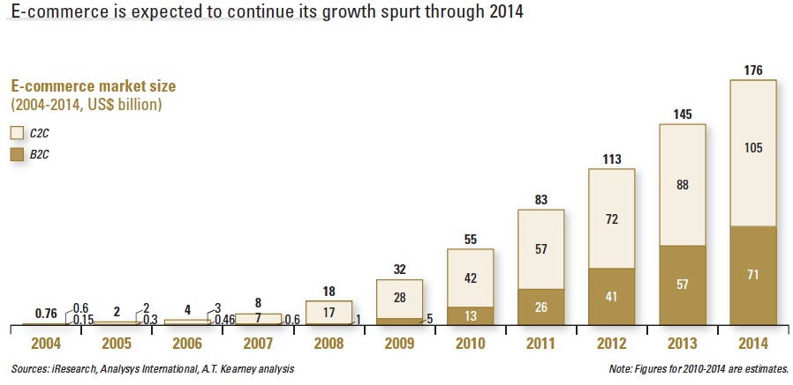
Appendix – E-Commerce

Slide 30
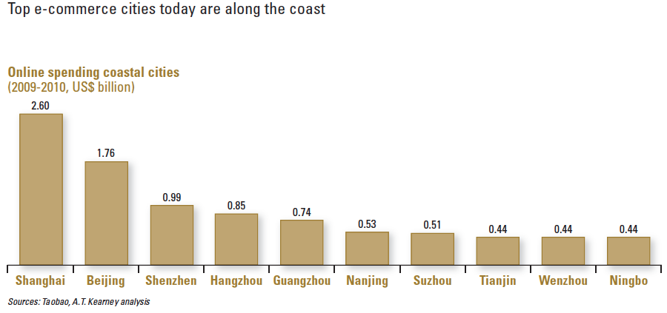
Appendix – E-Commerce

Slide 31
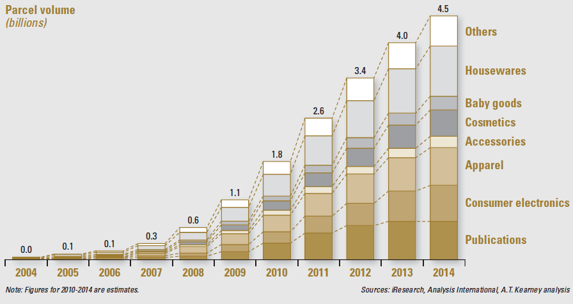
Appendix – E-Commerce

Slide 32
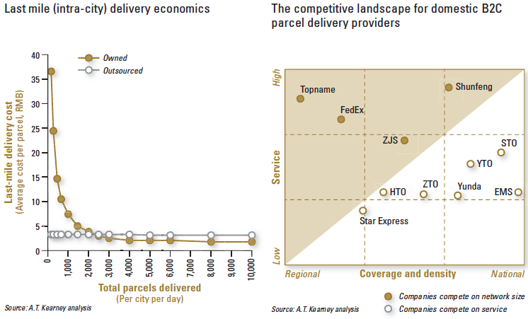
Appendix – Last mile delivery

Slide 33
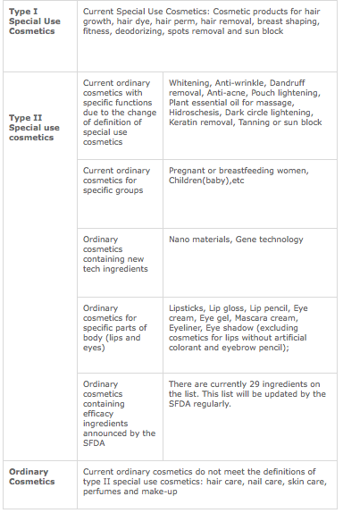
Appendix – Type II special use cosmetic
China SFDA classification of cosmetics and adjustment of registration requirements. 2012

Slide 34
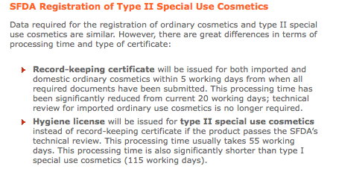
Appendix – Type II special use cosmetic

Slide 35
Appendix – Type II special use cosmetic
Product formula
Brief description and diagram of production process
Standards and procedures for product quality and safety control
Original packaging of products (including product label and product information sheet)
Testing report and relevant data from inspection organization certified by Ministry of Health of China
Safety assessment data for cosmetics containing potential high-risk substances
Stamped copies of power of attorney and business license of Chinese responsible agent
Letter of commitment stating that the cosmetic ingredients meet the restriction requirements of high-risk substances from regions with high incidence of mad cow disease
Permit to manufacture or sell cosmetics at the country (region) of origin
1 un-opened sample and other materials which are helpful for review

Slide 36
Appendix -Finance
 |  | FY1 | FY2 | FY3 | FY4 | FY5
Product | Cloud Services | 20,000.00 | 25,000.00 | 30,000.00 | 35,000.00 | 40,000.00
 | Product testing | 5,000.00 | 8,000.00 | 8,500.00 | 9,000.00 | 9,500.00
 | IP protection | 30,000.00 | 10,000.00 | 5,000.00 | 5,000.00 | 5,000.00
 | App development | 30,000.00 | 12,000.00 | 14,000.00 | 16,000.00 | 18,000.00
 | Licensing/Royalities(1.5%) | 40,000.00 | 52,800.00 | 158,400.00 | 316,800.00 | 475,200.00
Manufacturing | Mixer | 65,000.00 | 500.00 | 500.00 | 500.00 | 500.00
 | Packaging | 30,000.00 | 250.00 | 250.00 | 250.00 | 250.00
 | Rental | 30,000.00 | 30,000.00 | 30,000.00 | 36,000.00 | 48,000.00
 | Warehouse | 0.00 | 12,000.00 | 36,000.00 | 72,000.00 | 108,000.00
 | Manpower | 168,000.00 | 368,000.00 | 630,000.00 | 714,000.00 | 798,000.00
 | Regulatory Redtap | 20,000.00 | 25,000.00 | 30,000.00 | 35,000.00 | 40,000.00
 | Insurance | 10,000.00 | 10,300.00 | 10,600.00 | 10,900.00 | 11,200.00
 | Other Variable Cost | 20,000.00 | 40,000.00 | 42,000.00 | 44,000.00 | 46,000.00
Marketing & Sales | Website | 500.00 | 500.00 | 500.00 | 500.00 | 500.00
 | Social Media | 20,000.00 | 25,000.00 | 30,000.00 | 35,000.00 | 40,000.00
 | Wechat | 2,000.00 | 3,000.00 | 4,500.00 | 6,750.00 | 7,087.50
 | Tabao | 2,000.00 | 3,000.00 | 4,500.00 | 6,750.00 | 7,087.50
 | Alibaba | 2,000.00 | 3,000.00 | 4,500.00 | 6,750.00 | 7,087.50
 | Online marketing | 100,000.00 | 140,000.00 | 196,000.00 | 274,400.00 | 384,160.00
 | Mobile marketing | 100,000.00 | 140,000.00 | 196,000.00 | 274,400.00 | 384,160.00
 | Endorsement | 20,000.00 | 500,000.00 | 1,000,000.00 | 2,000,000.00 | 3,000,000.00
 | Customer service | 10,000.00 | 20,000.00 | 40,000.00 | 80,000.00 | 160,000.00
 | Customer engagement | 100,000.00 | 300,000.00 | 900,000.00 | 2,700,000.00 | 8,100,000.00
 | Indirect Expanse | 824,500.00 | 1,728,350.00 | 3,371,250.00 | 6,679,000.00 | 13,689,732.50
Raw Material | siRNA | USD
 | Hydrogel base | 1.02
 | applicator | 5.86
 | Inventory | 0.5
Distribution cost | Topname | 3
Cost per unit | 10.38
Retail price | 88

Slide 37
Contingency (Cost rise from 10.38 to 20/unit)
Appendix -Finance
 | FY1 | FY2 | FY3 | FY4 | FY5
NPBT | -824,500.00 | 981,650.00 | 4,758,750.00 | 9,581,000.00 | 10,700,267.50
NPAT (25%) |  | 363,275.00 | 3,569,062.50 | 7,185,750.00 | 8,025,200.63
Risk Group | Early Startup | First Stage | Second Stage | Second Stage | Late Startup
Risk Rate | 50-70% | 40-60% | 30-50% | 30-50% | 10-35%
Discount Rate | 65% | 60% | 50% | 45% | 35%
Discount Factor | 0.61 | 0.55 | 0.46 | 0.41 | 0.3
Current Value | -502,945.00 | 199,801.25 | 1,641,768.75 | 2,946,157.50 | 2,407,560.19
Perpetuity growth model | 6%
Continuing value | 44,772,171.91
Discounted continuing value | 14,670,945.29
Equity Value | 21,363,287.98
35% Equity | 7,477,150.79
ROI | 7.48

