Slide 1

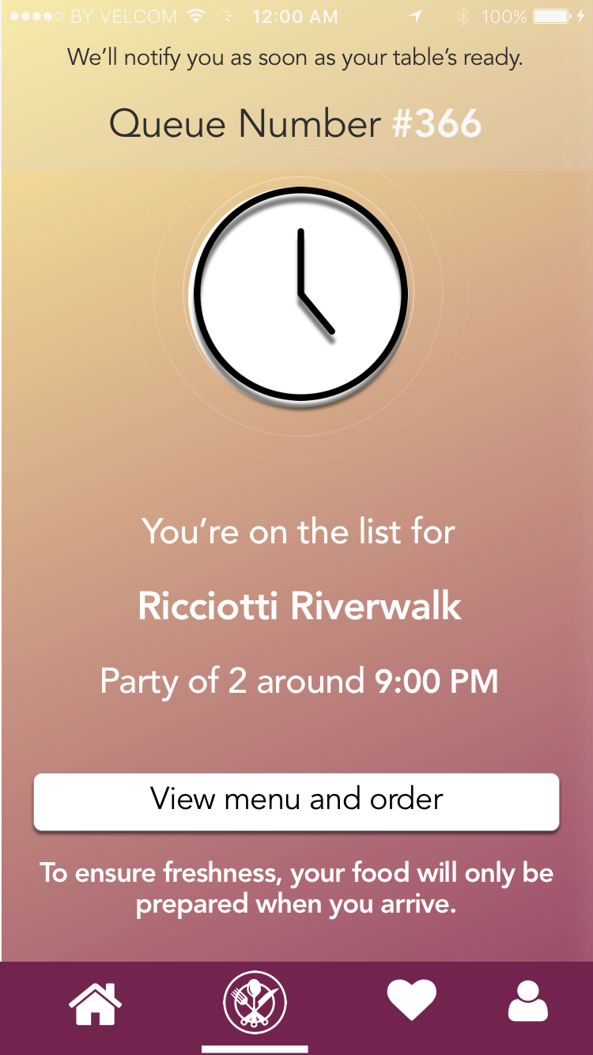
JustDine
Less waiting,
more living
Notes:
Introducing JustDine!

Slide 2
Our Challenge
Manpower shortages are due to underlying service inefficiencies in the queue management, ordering and payment processes.
To increase productivity of service crew by streamlining the process of queueing and ordering in.
Notes:
our problem statement is define as To increase productivity of service crew by streamlining the process of queueing and ordering in.

Slide 3
Customer Journey
Wait
to enter
Wait
to order
Wait
to eat
Wait
to pay
Notes:
So, this is a typical process of a customer journey.
Wait to be seated, wait for order to be taken, wait for the food to arrive and wait to set the bill.

Slide 4

Employee Journey
Wait
to enter
Wait
to order
Wait
to eat
Wait
to pay
Notes:
Right smacked in the middle of this, is the poor service staff that have to address all of the customers touchpoint

Slide 5
Solution
Book, pre-order, and pay
Eat
Notes:
So our solution is to: streamline the process of
queue management
ordering
payment
So the customers has a better experience and the service staff is less stress.

Slide 6
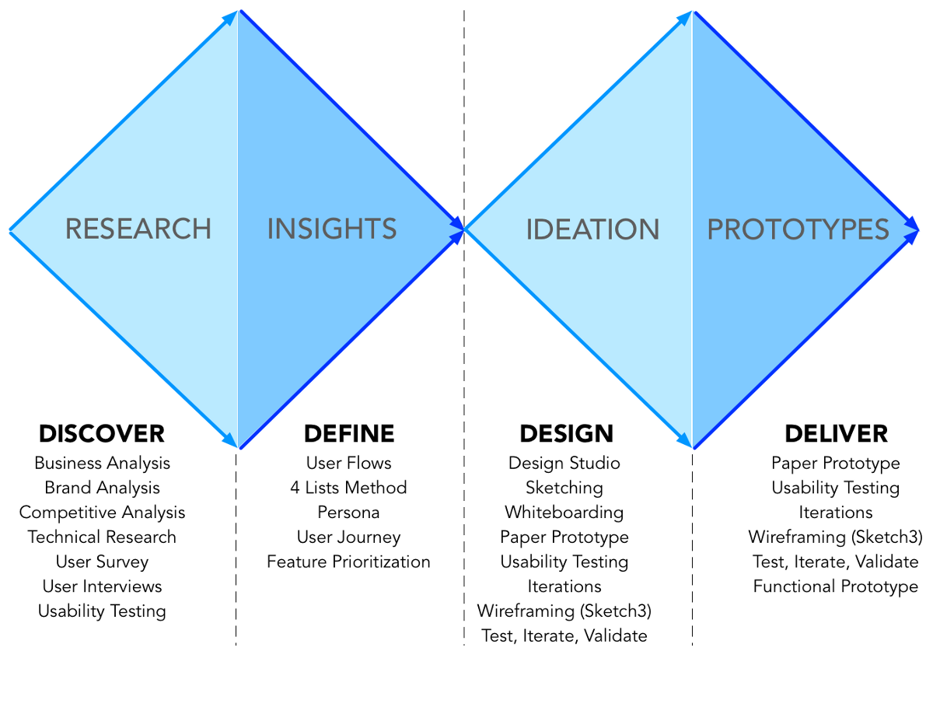
Research
Notes:
Here is framework of how we apply design thinking process.
Gatherign first-hand insight of 5 target users felt from queuing up to all the way down to the payment process.

Slide 7
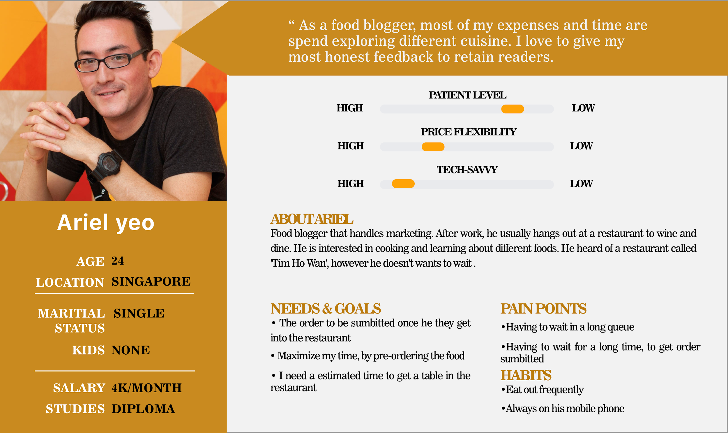
Persona
Maximising his time getting a queue number, while he can do something other activities (eg shopping..etc)
Advance Ordering to provide convenience
Notes:
We crafted out a persona, Ariel
So.. Ariel want to maximise his time, rather than just waiting in line. Also, he want to make his order in-advance.

Slide 8
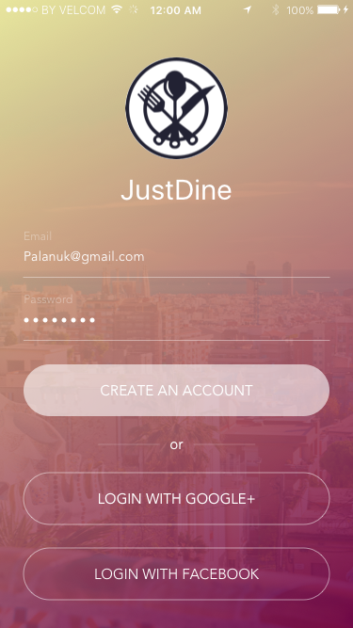
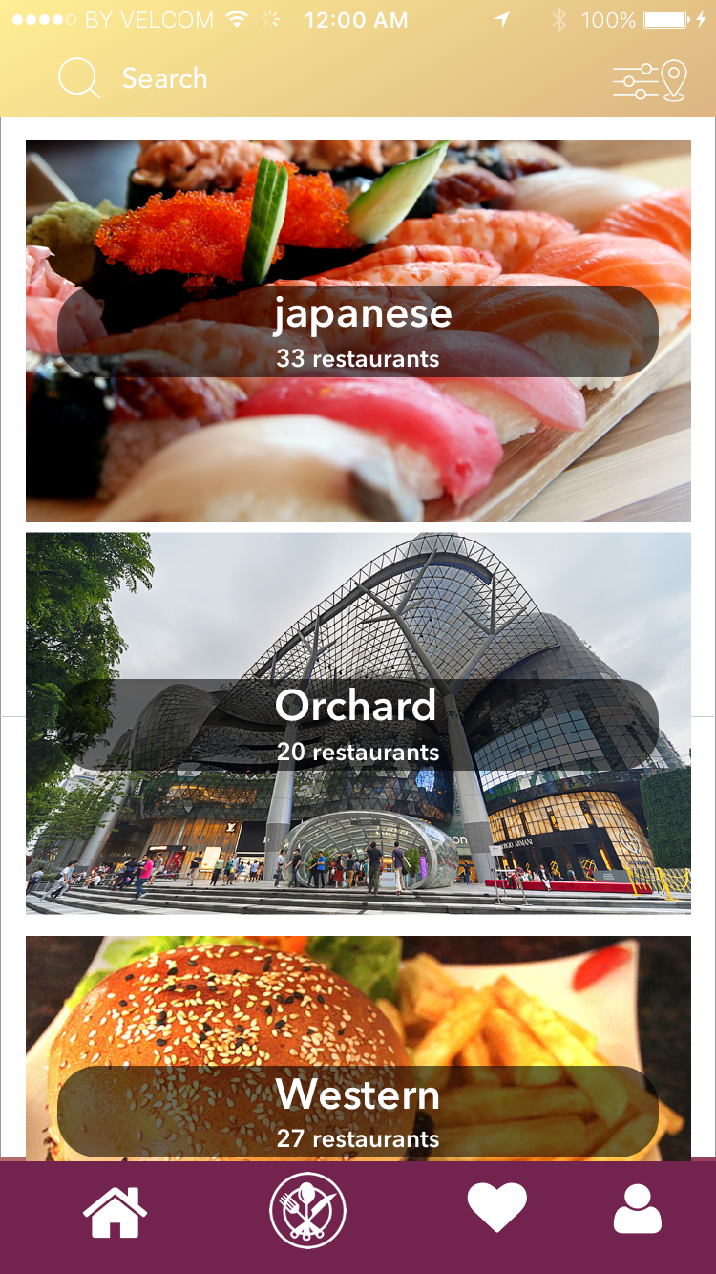
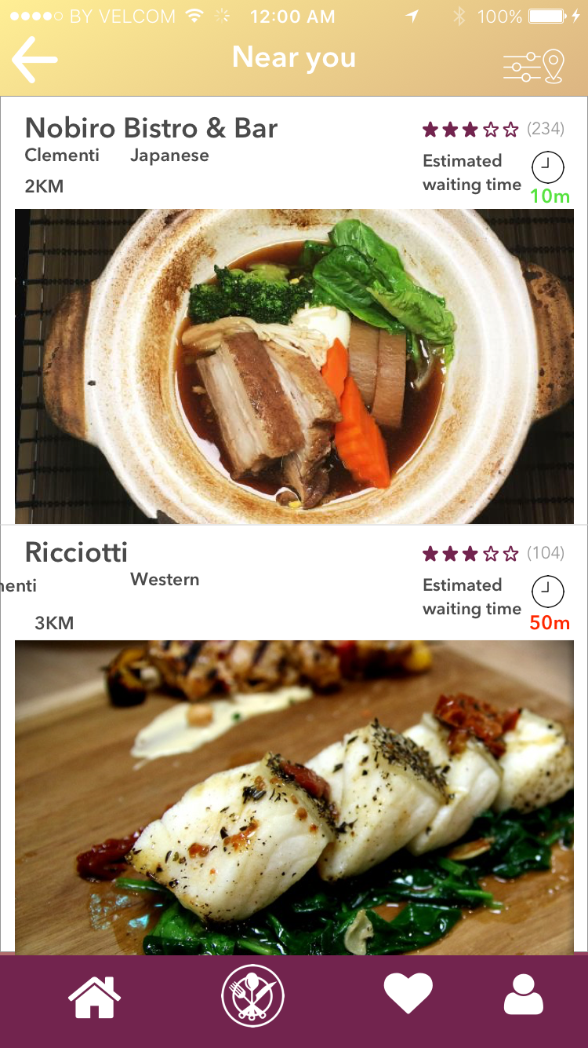
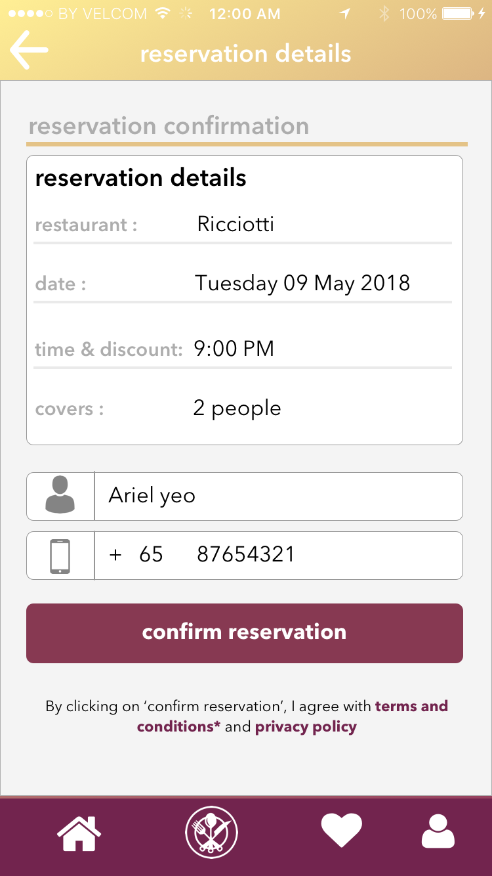
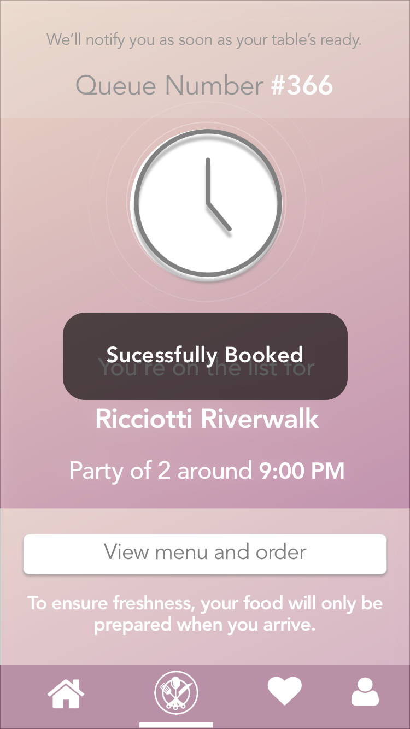
App Work Flow
Log in
Explore
Estimated waiting time
Reservation
Queue number
Notes:
Here are some of the key features of our app,
Firstly, the estimated waiting time to get seated
Secondly, after making a reservation. Users will get a queue number. Upon getting a queue number, users can

Slide 9
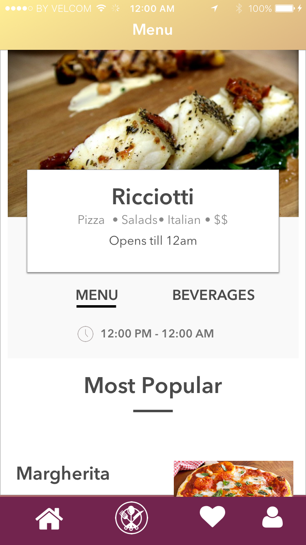
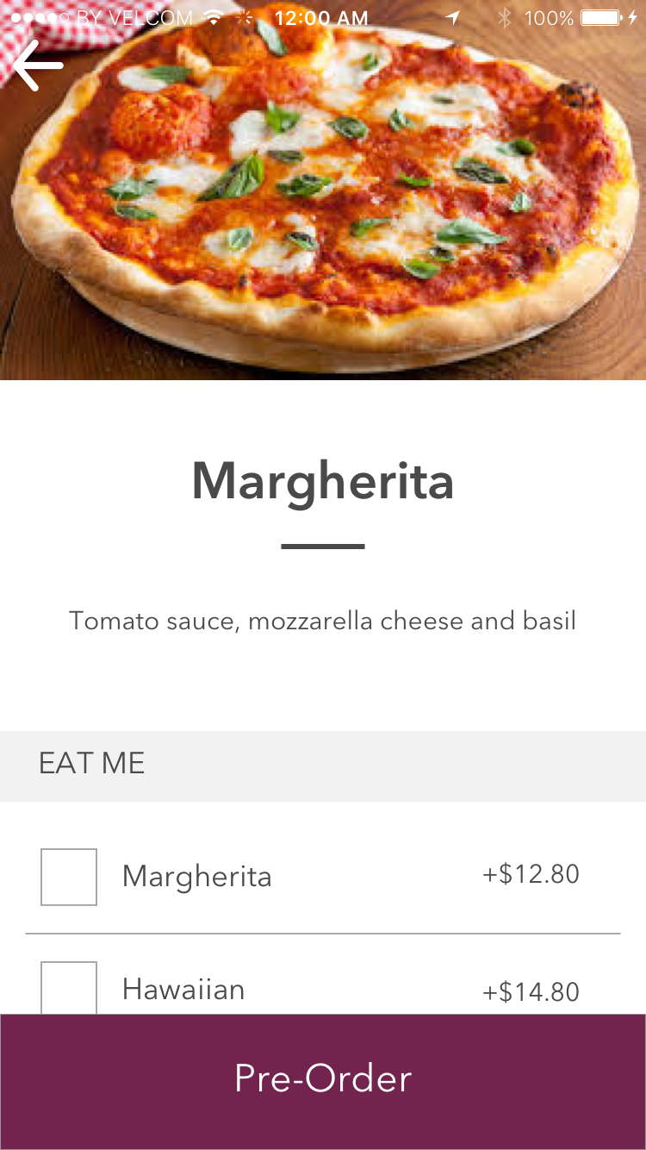
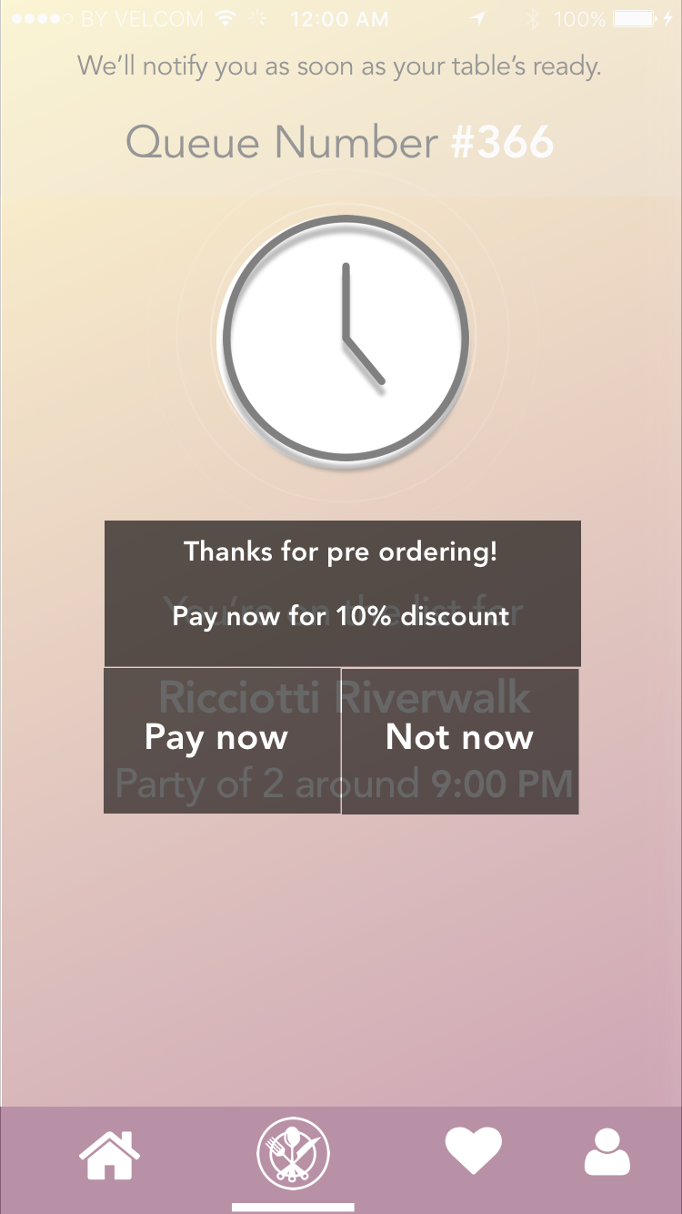
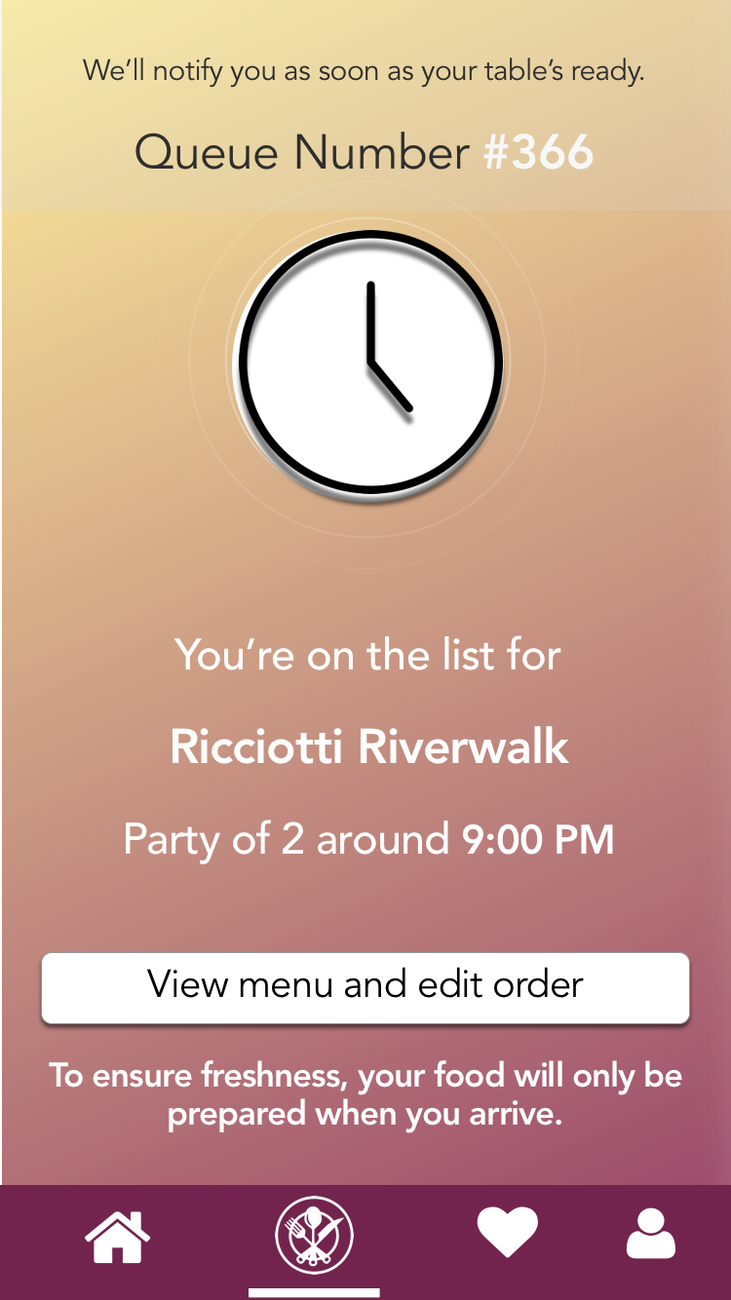
App Work Flow (Pre-Order/Payment)
View menu
Explore
Ordering
Payment
Notes:
users are given the choice to view menu to order and have the option to make payment in-advance.
So to encourage users to pay before, we incentify them by giving them a 7% discount on their total bill. In so doing, reducing manpower needed for settling the bills.

Slide 10

Business Model
$3 billion
F&B Industry, 2015
We take a 10% commission
0.5%
market share
$6.5 million
$650k
$1.3 billion
JustDine Market Opportunity
Restaurants
Notes:
We validated this idea by approaching 5 restaurant owners, and all 5 expressed an interest in JustDine.

Slide 11




Value Proposition
Preorder for dining in
Order early
Spend less time in restaurant deciding
More time for kitchen to prep
Improve productivity
Reduce operational costs
Manage your staff better
App-based solution
Readily available to customers
Customers are empowered to DIY

Slide 12
Timeline
Analytics
Customer insights
Partnership
Nearby shops for deals
May 2017
Feb 2018
Oct 2017
Jun 2018
Gamification
Loyalty points
Advertising
User acquisition

Slide 13





Summary
Better allocation of manpower
Less time spent/customer
Increase in productivity
Higher
customer turnover
Notes:
To iterate, we address manpower shortage in restaurants by reducing service crew workload. Firstly, by anticipating orders, the manpower crunch at peak hour is reduced. Secondly, higher customer turnover means more customer per labor hour which is an increase in productivity. Therefore, we have happier customers and service crew.

Slide 14


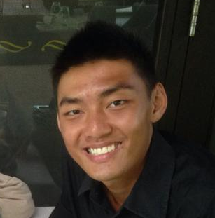
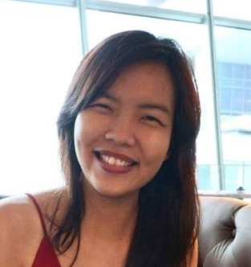

Thank You!
first
first
Mark Ong
General Assembly UX graduate
Chee Ming
11 years in F&B
International prize winning entrepreneur
first
first
Ruth Ong
ShopBack early employee
Great cook
Jackie Tan
Startup founder
Built app solutions for P&G, QuintilesIMS, and National Design Council

