Slide 1
Quail: Quantum Understanding and AI for Interpretability and Learning
Dr Jackie Tan, Team Quail
For submission to the
Future Leaders in Quantum (FLIQ) Hackathon

Slide 2

Ex-Associate Professor in Data Science (Nanyang Technological University), 3x serial entrepreneur
Research at Center of Quantum Technologies (National University of Singapore)
Broad areas of expertise = AI + web3
Broad domains = fintech + DS + edu

Slide 3
Agenda
Problem
Solution
Approach
  Classical approach
  VQA approach
  Dashboard
Results
Limitations
Future Work
Conclusion

Slide 4
Problem

Slide 5
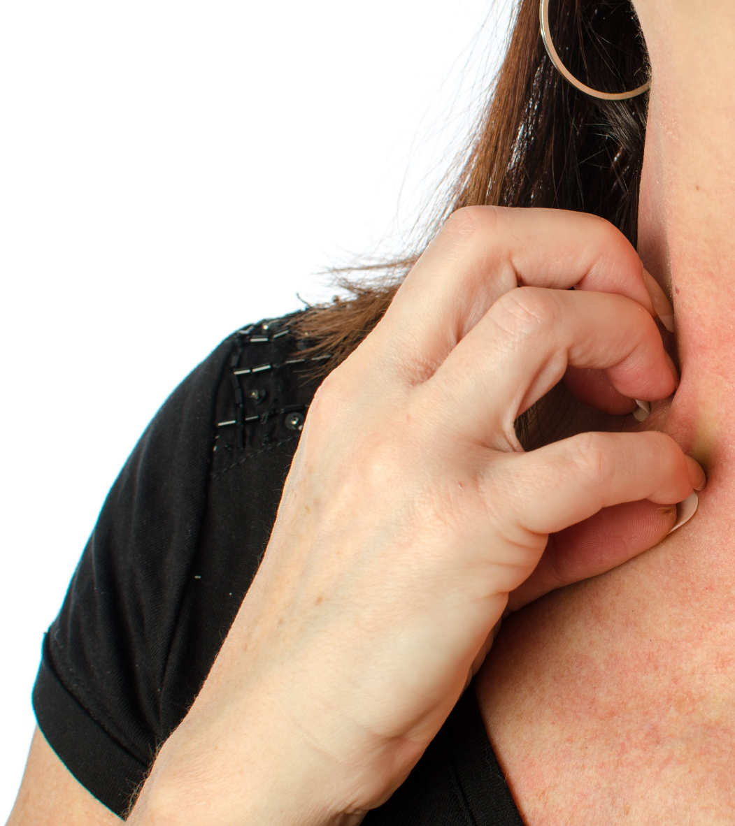
Drug-induced allergies are life-threatening
Drug-induced allergies (DIA) are hard to predict
Active area of research
A strong need for pharmacovigiliance

Slide 6
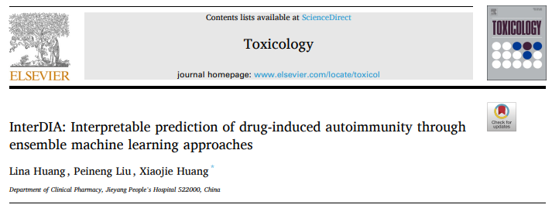
New research has emerged with useful data

Slide 7
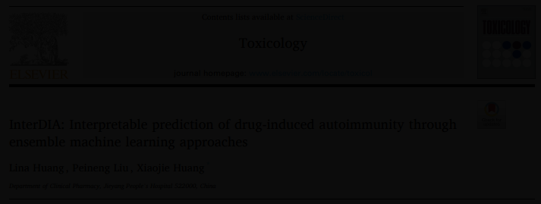
New research has emerged with useful data
Generated physicochemical properties of non-DIA and DIA-inducing drugs
Separate train (477) + test (120) set
196 features, very high dimensional
Imbalanced dataset, 25% DIA-inducing vs non-inducing

Slide 8
Solution

Slide 9

QML leverages expressivity of quantums states
QML models complex, high-order correlations in data:
Feature map
Ansatz
Measurement + Optimization
QML might learn patterns that classical models might miss!
High-dim data -> PCA -> Feature map -> VQA -> Prediction

Slide 10
Approach

Slide 11
Project in Parts
Part I: Exploratory Data Analysis
Part II: Data Processing
Part III: Benchmarking using Classic ML
Part IV: Performing VQA to Predict DIAs
Part V: Quantum Feature Importance

Slide 12
Workflow
Perform classic ML
Exploratory Data Analysis
Preprocess data
Decompose using PCA
QML feature importance
QNN-based modelling

Slide 13
Results

Slide 14
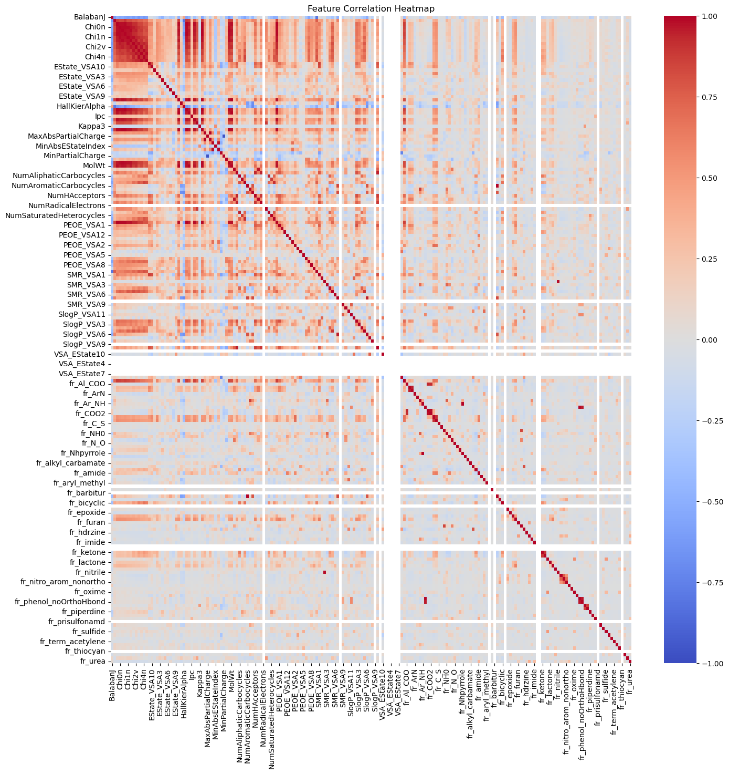
High number of correlated features
Possibility of performing dimension reduction
Dimension reduction = we can use a small number of qubits

Slide 15
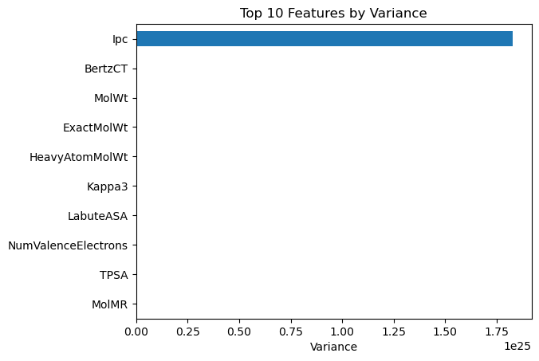
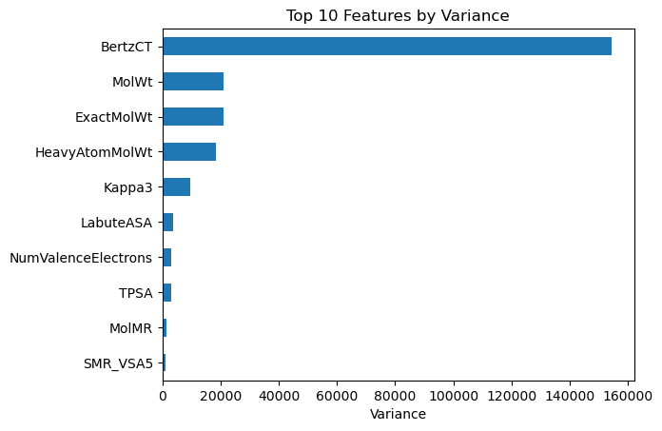
Large variance in top 10 features necessitates scaling

Slide 16
QML performance is comparable to trad ML
 | Traditional ML (Original)
 | Logistic regression | Random Forest | 6-component PCA + RF
Accuracy | 25% | 81% | 76%
F1-score | 0.4 | 0.48 | 0.36
Recall | 0.62 | 0.82 | 0.68
Precision | 0.5 | 0.66 | 0.60

Slide 17
QML performance is comparable to trad ML
 | Traditional ML (Scaled) |  |  | Quantum ML (Scaled, RealAmplitudes)
 | Logistic regression | Random Forest | 6-component PCA + RF | 2 qubits | 4 qubits | 6 qubits
Accuracy | 74% | 81% | 82% | 60% | 50% | 56%
F1-score | 0.31 | 0.5 | 0.48 | 0.43 | 0.29 | 0.36
Recall | 0.62 | 0.80 | 0.82 | 0.58 | 0.47 | 0.53
Precision | 0.57 | 0.67 | 0.66 | 0.60 | 0.47 | 0.54

Slide 18
QML performance is comparable to trad ML
 | Traditional ML (Scaled) |  |  | Quantum ML (Scaled, EfficientSU2)
 | Logistic regression | Random Forest | 6-component PCA + RF | 2 qubits | 4 qubits | 6 qubits
Accuracy | 74% | 81% | 82% | 53% | 53% | 54%
F1-score | 0.31 | 0.5 | 0.48 | 0.38 | 0.30 | 0.38
Recall | 0.62 | 0.80 | 0.82 | 0.53 | 0.49 | 0.54
Precision | 0.57 | 0.67 | 0.66 | 0.54 | 0.48 | 0.55

Slide 19
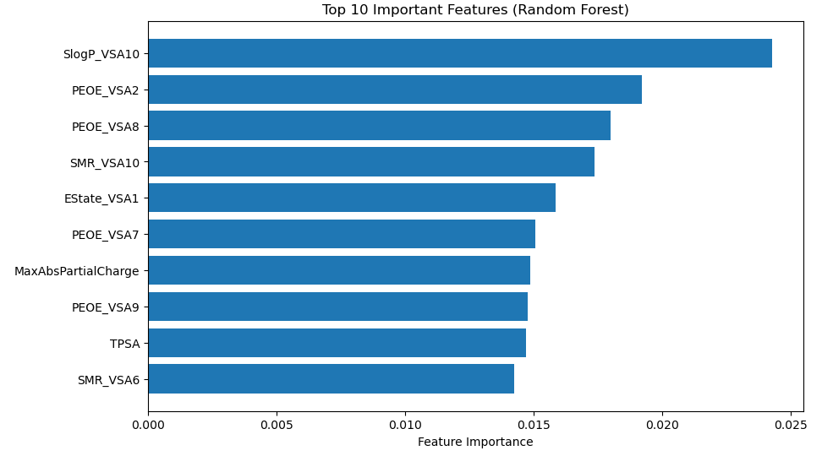
VQA models are explainable with input perturbations

Slide 20
VQA models are explainable with input perturbations
Perturb the inputs
Train model
Measure result
Calculate feature importance
Do nothing to inputs

Slide 21
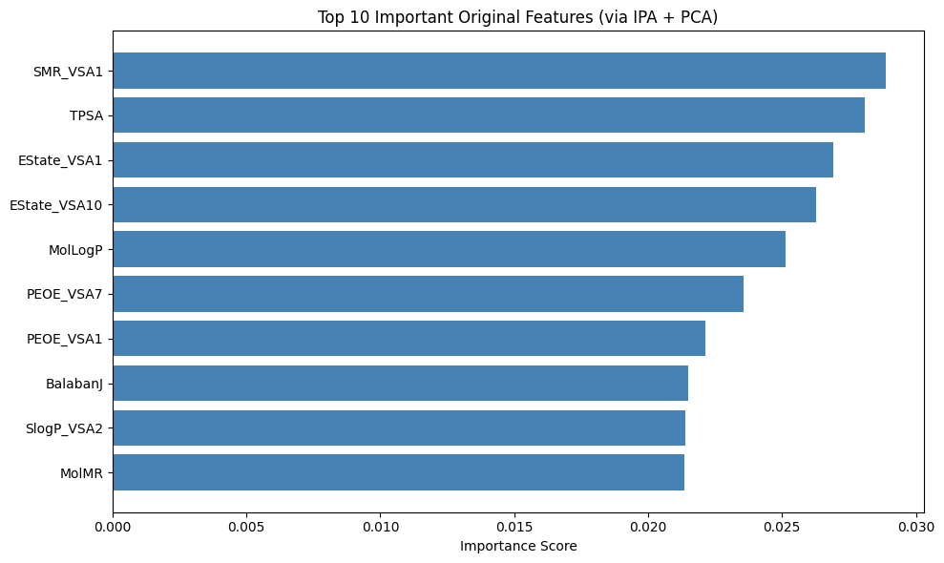
VQA models are explainable with input perturbations

Slide 22
Remarkable similarity in features
Similar class of features present in both images

Slide 23
Conclusion

Slide 24
VQAs hold immense potential for the future of ML
Quail did a great job under time and manpower pressure
Room for improvement for VQA performance
VQAs are able to handle decompositions from large dimensions
We used a novel perturbation-based method to do quantum feature importance
Promising performance with additional qubits

Slide 25
Let me win and send me to Geneva
I’m a good scientist with great ideas
I have the right mix of knowledge, expertise, and experience
I’ll rep us well, you won’t regret it!

Slide 26


Thanks
LinkedIn
@jackietanyen
Github Repo

